Slide 1



GLOBAL SUPPLY CHAIN ANALYSIS
PROJECT GUIDE
Mr.M.Neelamegan
AP/AI
PROJECT MEMBER
Pradakshina.S.B
Nithish.N
Yogananth.J

Slide 2
PROBLEM STATEMENT
In today's globalized economy, supply chains are becoming increasingly complex, spanning multiple countries and involving various stakeholders. This complexity leads to challenges such as limited visibility into real-time operations, difficulty in identifying potential risks, and inefficiencies in cost management and resource allocation.
Organizations struggle to make informed decisions due to fragmented data and a lack of centralized analytics. The aim of this analysis is to utilize Power BI to integrate and visualize global supply chain data, offering clear insights that enable better forecasting, risk mitigation, cost optimization, and more responsive supply chain management.

Slide 3
OBJECTIVE
The objective of this analysis is to leverage Power BI to create a comprehensive and interactive dashboard that provides real-time visibility into the global supply chain.
By integrating data from multiple sources, the goal is to identify bottlenecks, optimize inventory and logistics, mitigate risks, and enhance overall supply chain efficiency.
This will empower stakeholders to make data-driven decisions, improve operational performance, and respond swiftly to disruptions or changes in market demand.

Slide 4
EXISTING SYSTEM
The existing global supply chain management system often relies on fragmented data from multiple sources, which are typically siloed and lack integration. This leads to delayed decision-making, limited real-time visibility, and inefficient resource allocation.
Most organizations use outdated methods, such as static reports and spreadsheets, which provide only a snapshot of the supply chain at a given moment, making it difficult to track and respond to dynamic market conditions, demand fluctuations, or disruptions.
Additionally, the current system struggles to analyze vast amounts of data quickly, preventing timely identification of risks, inefficiencies, and opportunities for optimization.

Slide 5
DATASET LINK
https://www.kaggle.com/datasets/shashwatwork/dataco-smart-supply-chain-for-big-data-analysis
The dataset objective is to analyze the impact of shipping performance on customer satisfaction and behavior, as well as to examine category-wise sales performance and the benefit of orders. The dataset contains information about shipping, customer behavior, sales, and benefits, and the goal is to create dashboards and measures in Power BI to answer various questions and gain insights into these areas.

Slide 6
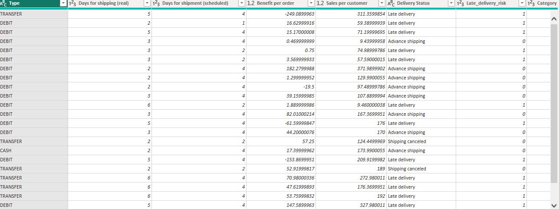
DATASET

Slide 7
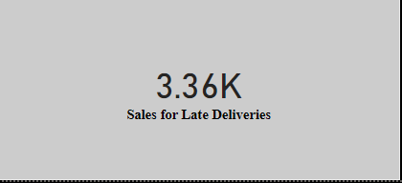
DATASET IS DESIGNED TO ADDRESS THE FOLLOWING QUESTIONS:
Create a measure to calculate the Total Sales per Region.
Create a measure to calculate the Late Delivery Rate by sales.

Slide 8
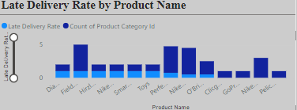
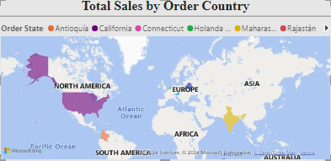
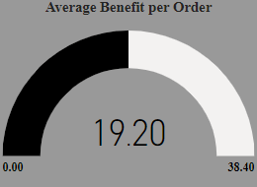
3. Use bar charts to display late delivery rates by product
4. Use geographical maps to show how total sales are distributed across regions.
5. Use charts to track sales trends over time in relation to average benefit per order

Slide 9
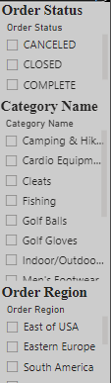
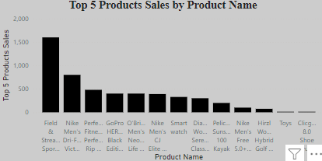
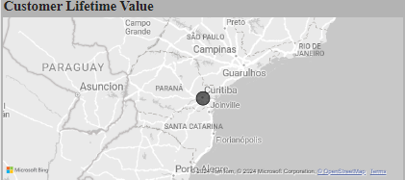
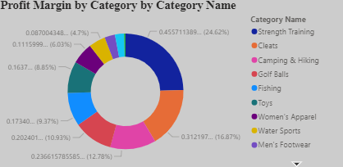
6. Enable filters or slicers by Region, Product Category, and Order Status to allow users to drill down and explore specific areas of interest.
7. Visualize Top 5 Products by Sales in Each Region
8. Create a measure total sales per customer as Customer Lifetime Value
9. Visualize Profit Margin by Product Category

Slide 10
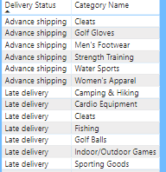
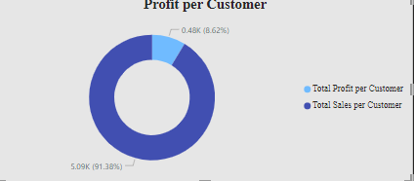
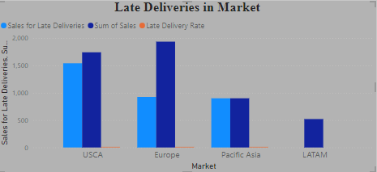
10. Using chart to show delivery status by category name
11. Visualize customer segments by total sales and profit.
12. Using chart to show the percentage of late deliveries based on market.

Slide 11
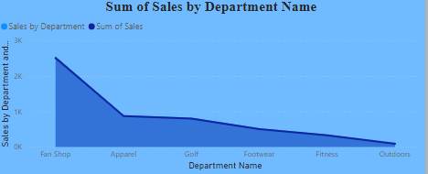
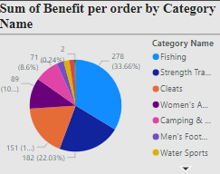

Create a measure to show sales performance for each department.
14.Create a measure to show benefit per order for each category.
15.Visualize the total sales for each Order region.

Slide 12
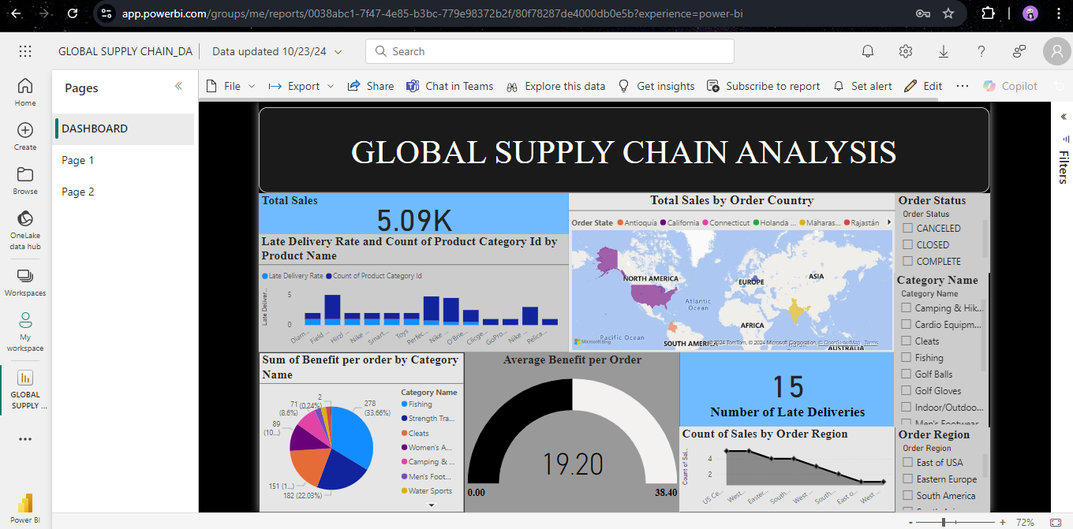
VISUALIZATION

Slide 13
REFERENCES
Mohan, N., & Bandyopadhyay, K. (2020). A systematic review of analytics applications in supply chain management: Insights and future directions. International Journal of Production Economics, 210, 151-171.
Soni, G., Jain, V., & Dubey, R. (2019). Leveraging big data analytics for improving supply chain performance: A framework and empirical study. Journal of Business Research, 117, 144-156.
Wang, Y., & Hsu, C. H. (2016). How analytics improves supply chain performance: An empirical examination. Decision Support Systems, 86, 97-106

Slide 14
THANK YOU

